Slide 1
Industrializing Advice: Databases Drive Scalable MFD Growth
The integration of client databases transforms advisory from manual transactions to scalable, industrial-grade wealth management.

Slide 2
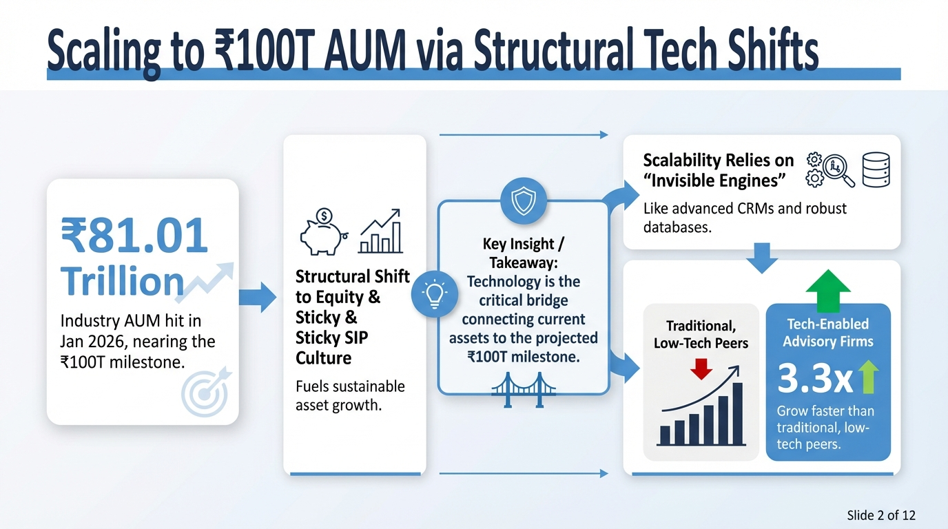

Slide 3
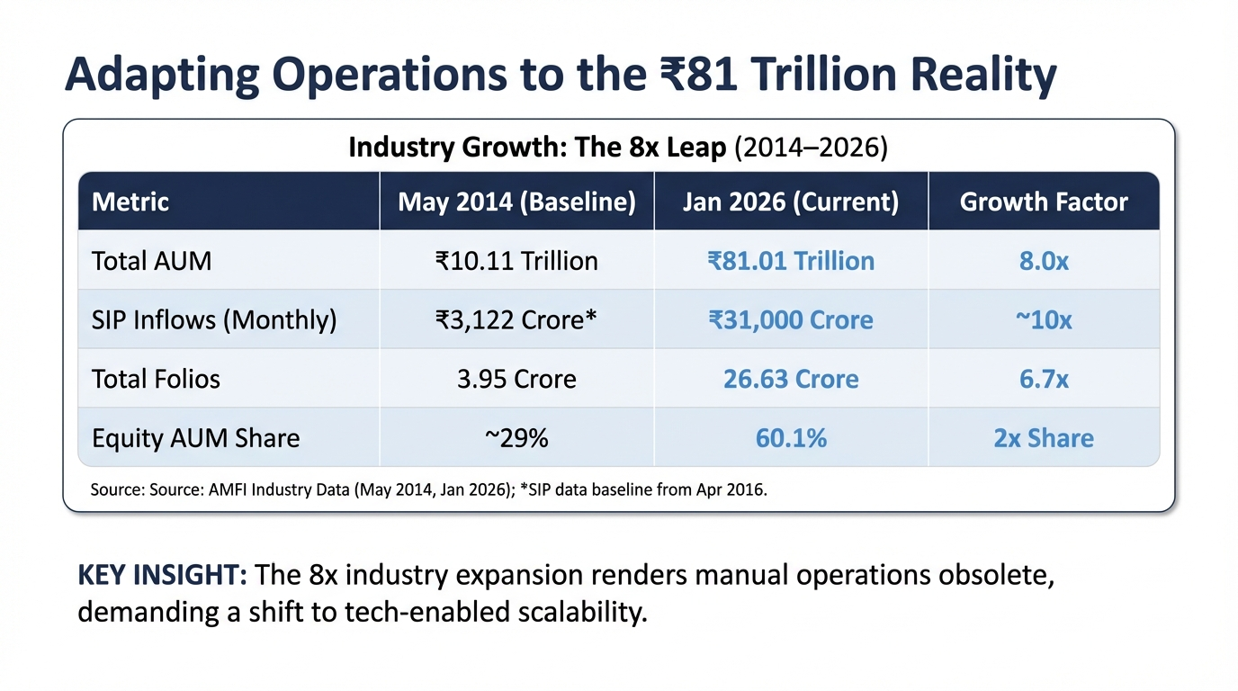

Slide 4
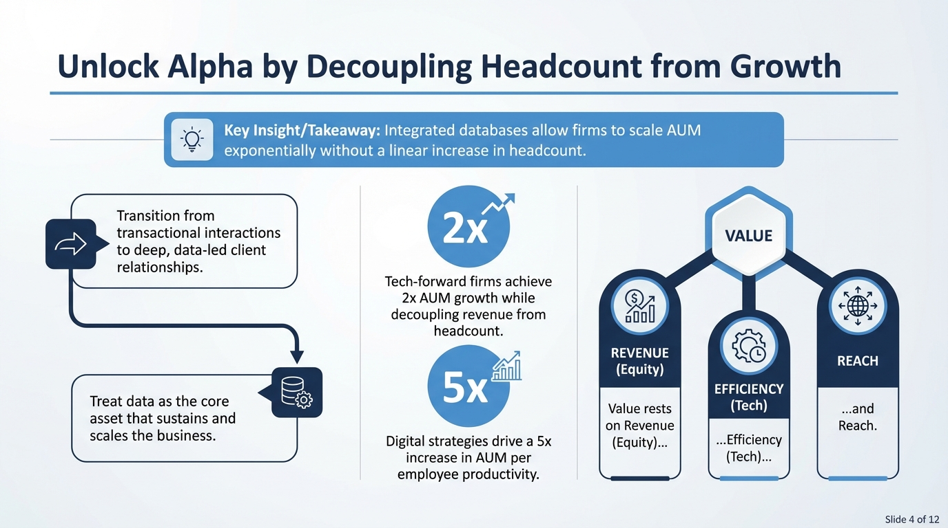

Slide 5
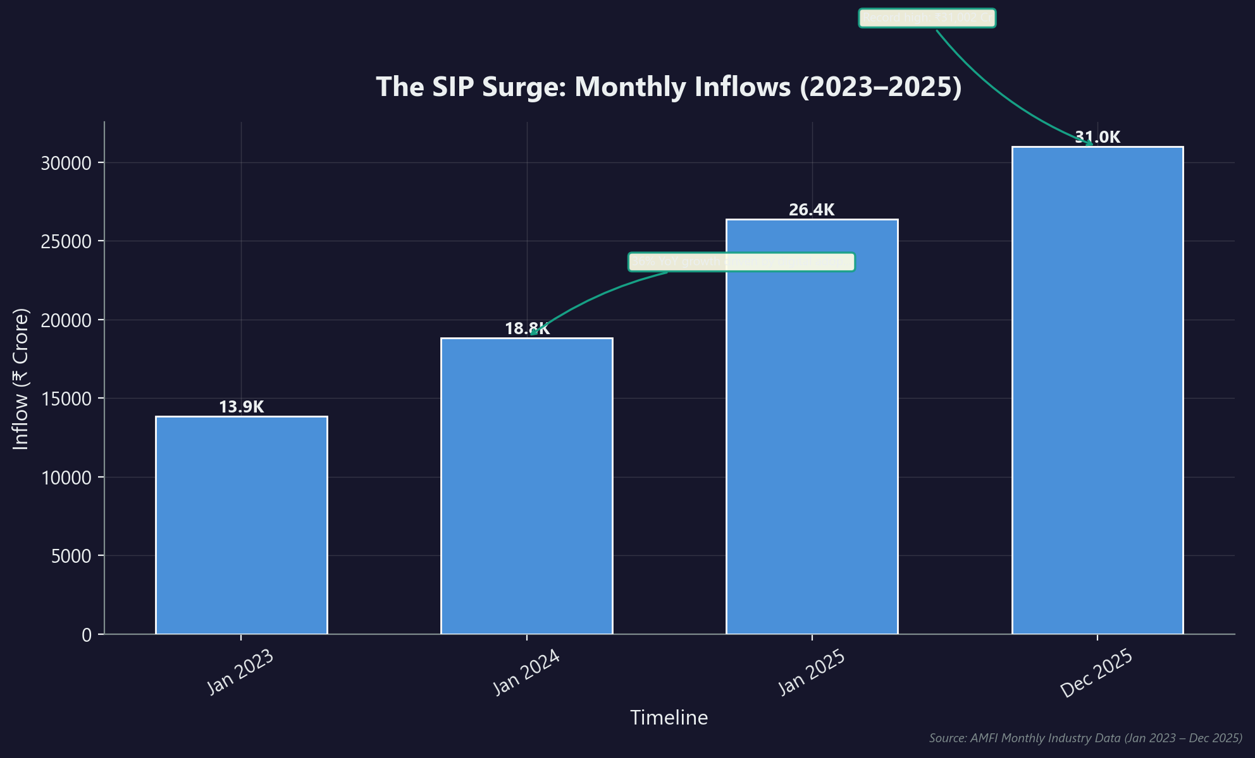
Automate Monitoring to Capture the Equity Revenue Pivot
▸ Equity-oriented schemes now comprise 59.7% of industry assets, up from 45% in 2019.
▸ Monthly SIP inflows surged 123% to ₹31,002 Crore between 2023 and 2025.
▸ Equity dominance requires active portfolio monitoring unlike passive debt-heavy models.
▸ Automated databases track rebalancing triggers across millions of folios instantly.
★ KEY INSIGHT: Equity dominance (~60% of AUM) demands data-led monitoring to manage volatility and sustain revenue.
Client Databases: The Invisible Engine Behind Scal...
Slide 5 of 12

Slide 6
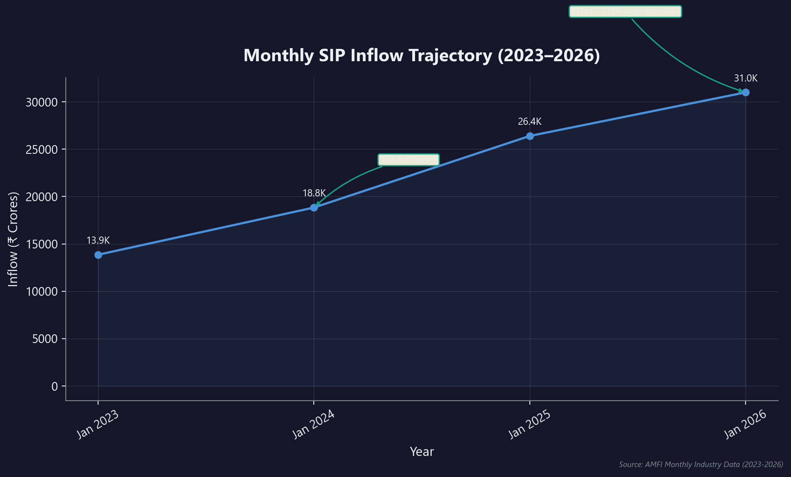
SIP Flywheel: Surging Inflows Drive Operational Complexity
▸ Monthly SIP book hit ₹31,000 Cr in Jan 2026, rising 123% since 2023.
▸ Active accounts reached 10.29 Crore, drastically increasing data management volume.
▸ Predictable inflows require minimal intervention only if digital mandates are robust.
▸ Industry added ~4.08 Crore net new accounts, compounding reconciliation efforts.
★ KEY INSIGHT: Consistent inflows of ₹31k Cr/month create a compounding data management challenge.
Client Databases: The Invisible Engine Behind Scal...
Slide 6 of 12

Slide 7
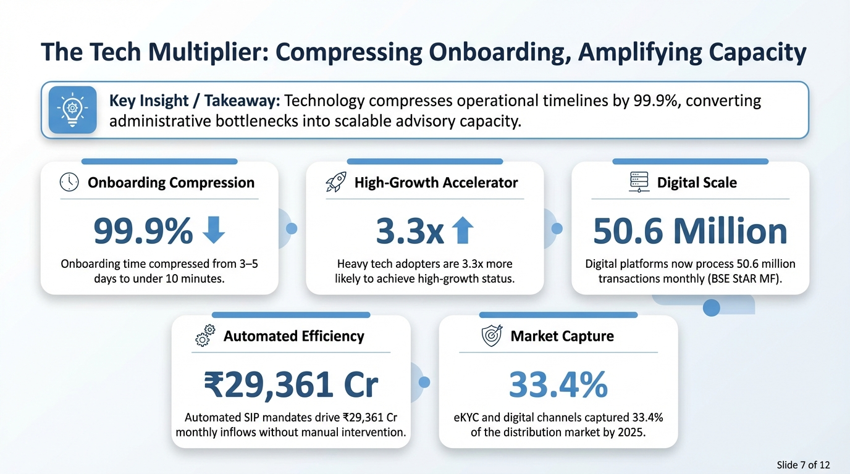

Slide 8
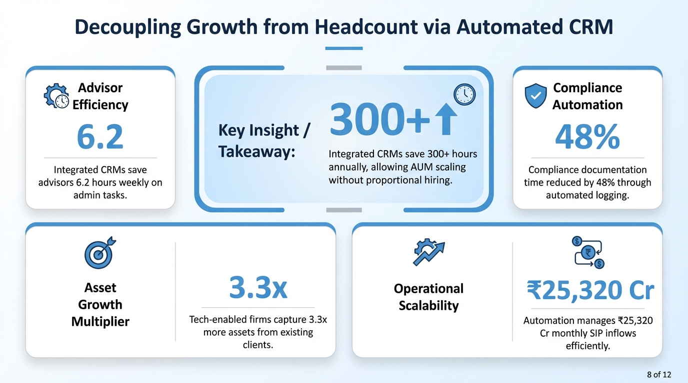

Slide 9
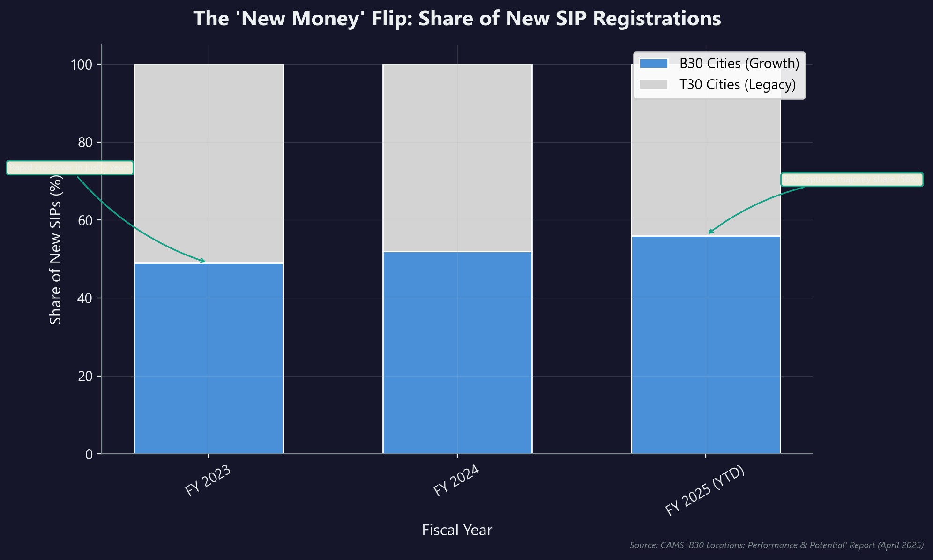
Scaling Reach: Digital Infrastructure Unlocks B30 Growth
▸ 56% of new SIP registrations now originate from B30 cities (FY25).
▸ B30 assets are high-quality, with 76.6% allocated to sticky equity schemes.
▸ Cloud infrastructure enables low-cost service for smaller, remote ticket sizes.
▸ Digital adoption surged, with 49% of B30 SIPs via Direct Plans.
★ KEY INSIGHT: B30 regions now contribute 56% of new inflows, accessible profitably only via low-cost digital channels.
Client Databases: The Invisible Engine Behind Scal...
Slide 9 of 12

Slide 10
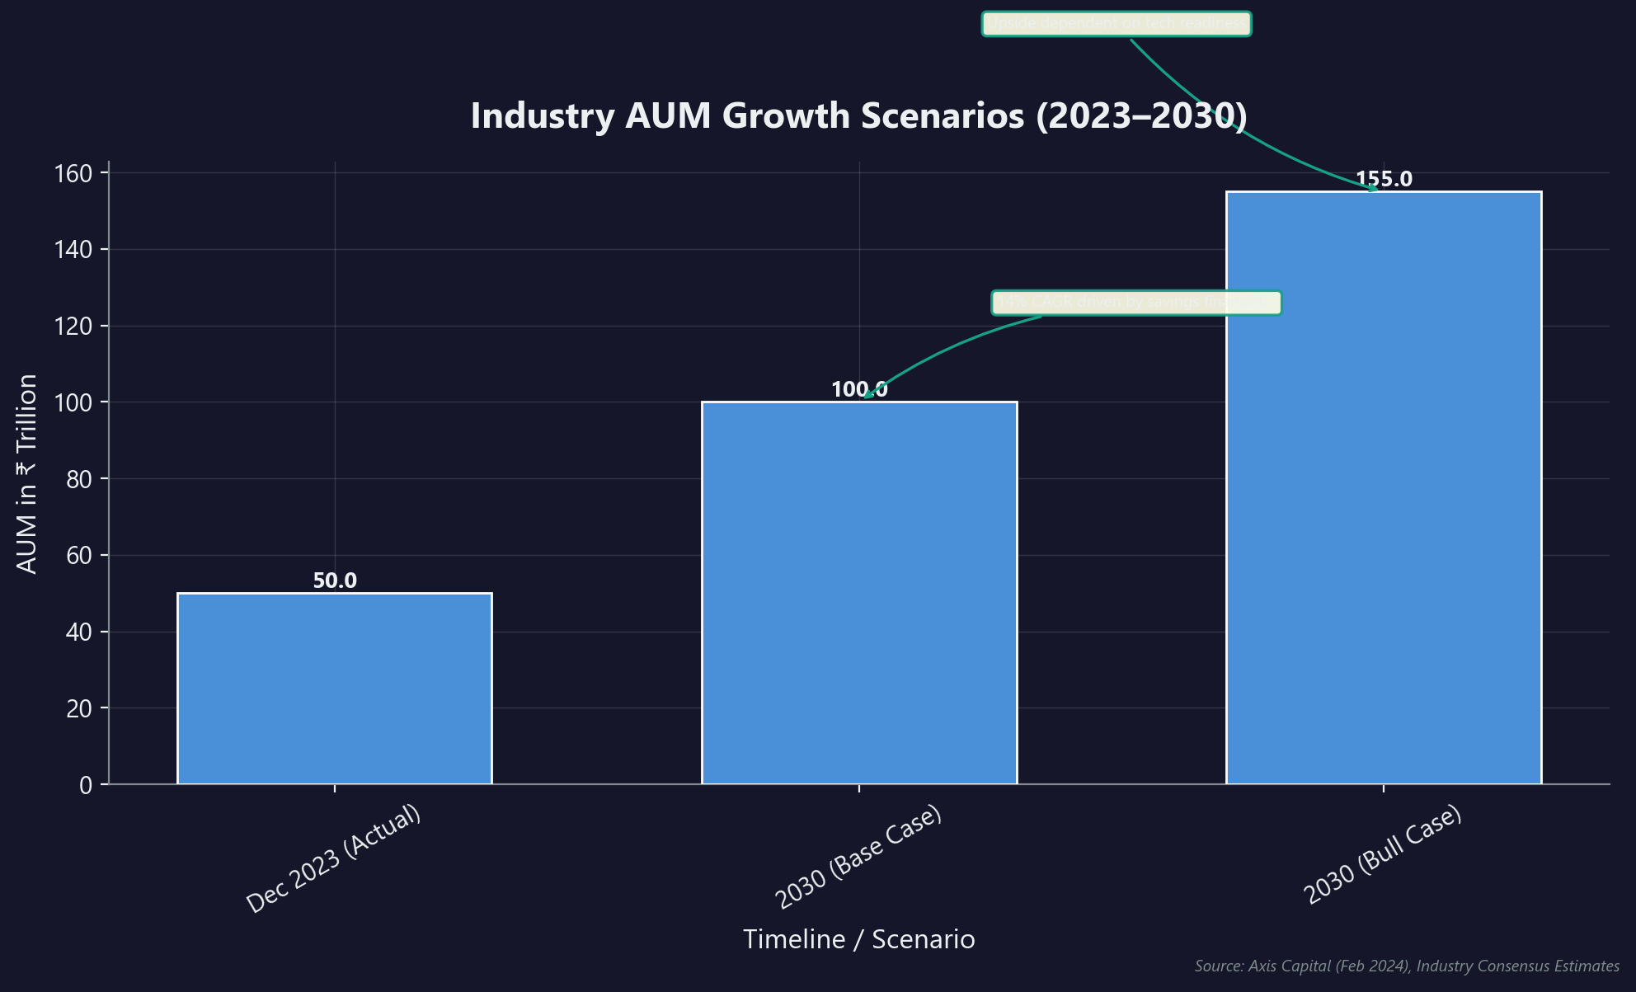
Targeting ₹100 Trillion AUM Through Tech-Driven Scale
▸ Conservative estimates project industry AUM doubling to ₹100 Trillion by 2030.
▸ Growth fueled by financialization of savings and ₹1 Trillion monthly SIP target.
▸ Tech-heavy firms are 3.3x more likely to achieve top-quartile growth rates.
▸ With 90% digital transactions, competitive edge shifts to data-driven advisory.
★ KEY INSIGHT: While market beta drives AUM to ₹100T, tech readiness is the alpha generator determining which firms capture the surplus.
Client Databases: The Invisible Engine Behind Scal...
Slide 10 of 12

Slide 11
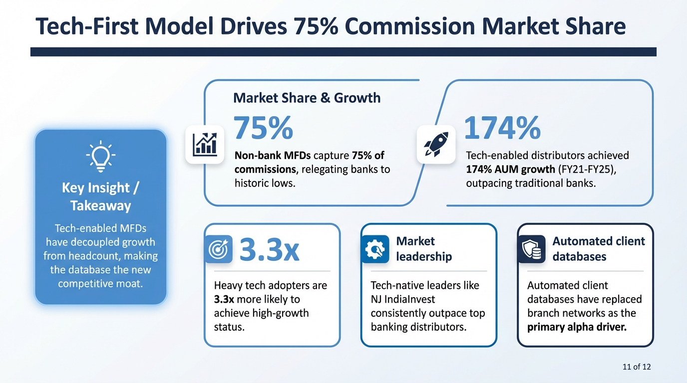

Slide 12
Prioritize CRM Investment to Automate Future Growth
Invest in the engine to win the race.

